Slide 1

DESIGN AND IMPLEMENTATION OF IMPROVED THREE PORT CONVERTER & INVERTER FED BLDC DRIVE
presented by
V.TANMAYA TULASI(18FE1A0265) V. RAJARSHI(18FE1A0268)
Y. KISHORE BABU (18FE1A0271) Batch no: 2
Sec: EEE-B
Under the guidance of
Dr. M. DIVYA , Ph. D

Slide 2
CONTENTS
Abstract
Introduction
Literature survey
Objectives
Proposed DC-DC converter
Mathematical model of Proposed ITPC
MPPT with various controllers
Perturb & Observe Algorithm
Fuzzy Logic Controller
Fuzzification Module
BLDC motor
Simulation diagrams
Simulation Results
Conclusion

Slide 3
ABSTRACT
This project involves the design and implementation of improved three interface converter, and B4-Inverter fed brushless direct electric current motor drive for industrial uses. The proposed integrated Three Port Converter (ITPC) and B4-Inverter fed Brushless Direct Current Motor (BLDC) drive is proposed.
It also involves design of MPPT controller to extract maximum power from the converter under various operating conditions. The static and dynamic response of the converter has been controlled with various controllers like PID controller and fuzzy controller and the comparison has been provided among various controllers. The results are validated by performing simulations of the proposed systems in MATLAB/Simulink.

Slide 4
INTRODUCTION
Even though PV energy has gained significant attraction over the past few years, the discontinuous nature of PV systems and the low conversion efficiency concerning PV modules are the huge obstructions for exploiting the PV source on a massive scale .
For the purpose of extracting the maximum power of the PV array, the conventional implementation of the maximum power point tracking (MPPT) in stand-alone systems is usually achieved by serially connecting a DC-DC converter between the PV array and the load and then having a bidirectional DC-DC converter in a parallel connection between the energy storage element and the load .
Energy storage element, such as the battery, is necessary for improving the system dynamics and steady-state characteristics. An Integrated Three Port Converter (ITPC) interfaced with solar, battery and motor is used. A B-4 Inverter between ITPC and BLDC.

Slide 5
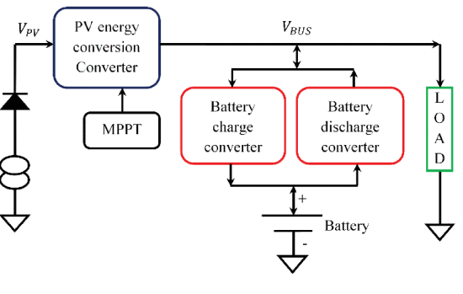
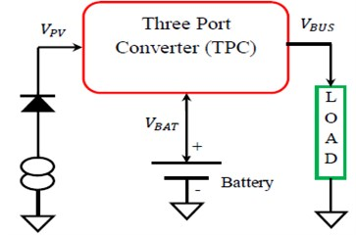
PROPOSED MODEL
Fig: Block diagram of TPC with two stage conversion
Fig: Block diagram of ITPC with single stage conversion(Proposed model)

Slide 6
LITERATURE SURVEY
Sathish Kumar Shanmugam et al., proposed design and implementation of improved three interface converter, and B4-Inverter fed brushless direct electric current motor drive for industrial uses. The proposed integrated Three Port Converter (ITPC) and B4-Inverter fed Brushless Direct Current Motor (BLDC) drive is proposed targeting low or medium applications.
Sathish Kumar Shanmugam et al., proposed an implementation of solar photovoltaic array and battery powered enhanced dc-dc converter using B4-inverter fed brushless dc motor drive system for agricultural water pumping applications. It consists of step up and step-down converter, DC-link module. DC-link switching is achieved by reduced ripple voltage which results in improved quality of obtained output power
Deng et al., a novel three-port dc/dc topology is proposed for this application. Pulse width and phase shift offer two degrees of freedom to effectively regulate the power flows. On the primary side, the input current ripple is reduced due to the interleaved structure. This avoids the usage of the bulky electrolytic capacitor on the PV terminal. On the secondary side, a voltage six folder rectifier is employed to boost the step-up ratio.

Slide 7
OBJECTIVES
This project involves design of three port DC-DC converter with solar input.
It involves design of various controllers based MPPT fed converter to control the output from the solar energy.
It involves design of inverter for the operation of BLDC motor attaining input from converter.
It also involves design of battery with bidirectional converter for steeping up or stepping down the voltage based on input condition.

Slide 8
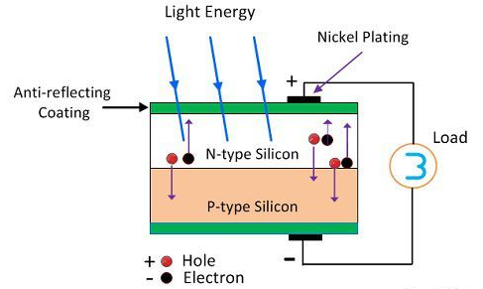
SOLAR ENERGY
Photovoltaic cells are made based on the principle of photovoltaic effect. When the light reaches the p-n junction the light photons can easily enter in the junction through very thin p-type layer.
The light energy, in the form of photons, supplies sufficient energy to the junction to create a number of electron-hole pairs. The incident light breaks the thermal equilibrium condition of the junction.
The free electrons in the depletion region can quickly come to the n-type side of the junction. Similarly, the holes in the depletion can quickly come to the p-type side of the junction.
Once, the newly created free electrons come to the n-type side, cannot further cross the junction because of barrier potential of the junction.
Fig: Working of PV Cell

Slide 9
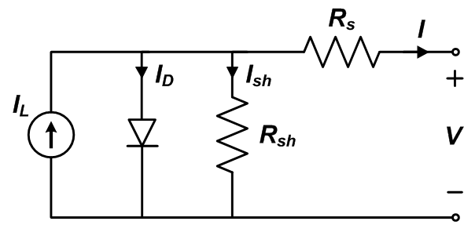


Equivalent circuit models define the entire I-V curve of a cell, module, or array as a continuous function for a given set of operating conditions.
The governing equation for this equivalent circuit is formulated using Kirchhoff's current law for current I.
$$I=I_{L}−I_{D}−I_{sh}$$
$$I_{sh}={\left(V+IR_{s}\right)}/{R_{sh}}$$
$$I=I_{L}−I_{0}\left[exp\left(\frac{V+IR_{s}}{nV_{T}}\right)−1\right]−\frac{V+IR_{s}}{R_{sh}}$$
$I_{module}=I_{cell}$ and $V_{module}=N_{s}×V_{cell}$

Slide 10
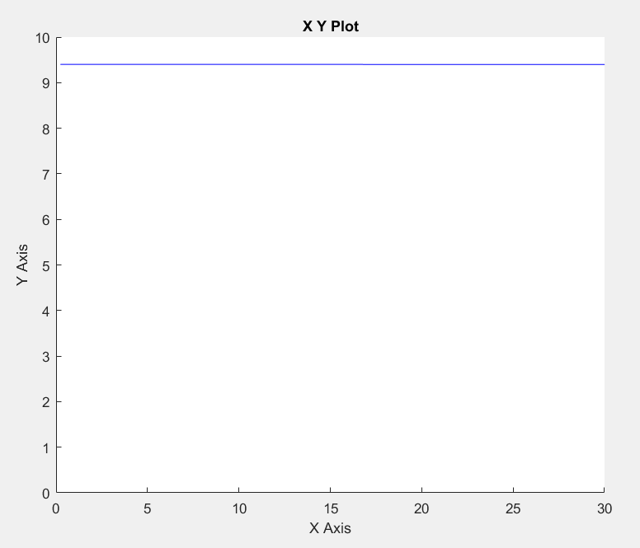
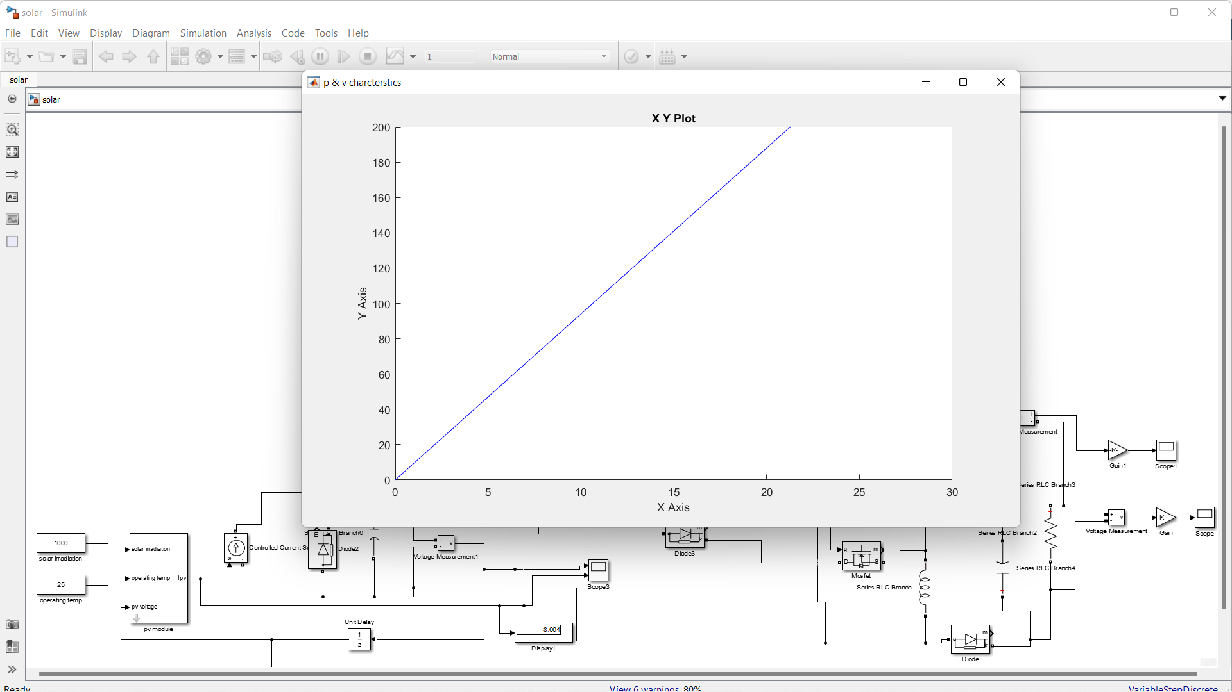
Fig: I – V characteristics of PV array
Fig: P – V Characteristics of PV array

Slide 11
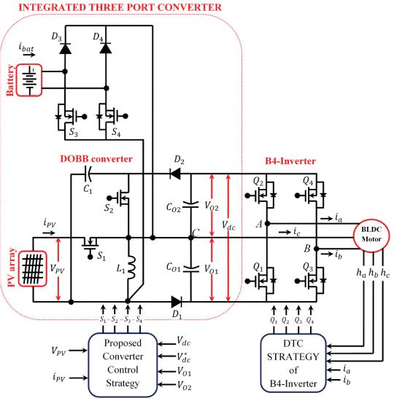
Circuit Diagram with Proposed system
Fig: A substitute proposition of the ITPC converter for the execution of the B4-inverter fed BLDC motor drive system with a phase change framework

Slide 12
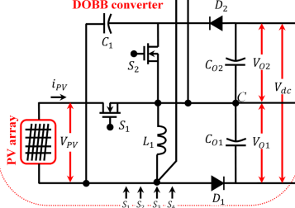
Proposed DC-DC Converter
The framework proposed will work in different power stream modes such as battery charging area (BCD), PV space (PVD) and battery releasing space (BDD).
In the Battery Charging Domain (BCD) mode, the PV charges the battery. The bidirectional converter works as a buck converter in the BCD.
This happens if the PV power is extremely contrasted with the heap control and if the PV voltage is higher than the battery voltage required, indicating that the battery must be charged.
Fig: Proposed DC-DC converter

Slide 13
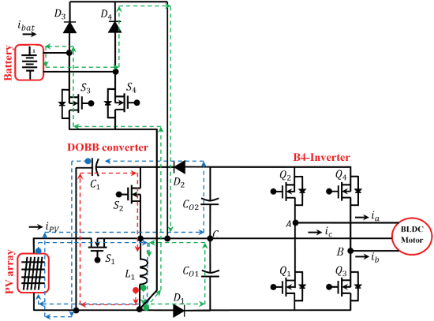
BCD Mode of Operation
In the Battery Charging Domain (BCD) mode
switch S₄ is always in off condition
Mode A: The switch, S₂, is turned on and switches S₁, S₃, S₄ are off.
Mode B:The switch S1 is turned on and switches S₂, S₃, S₄ are off.
Mode C: The switch, S₃ is turned on and switches S₁, S₂, S₄ are turned off.
Mode D: switches, S₂ and S₃ are turned on and switches S₁, S₄ are turned off.
PVD Mode of Operation
In the PVD mode, the value of the load current is equal to the PV module current; the power that is handled by the bidirectional converter is zero.
Here, the efficiency of the power network is near 95% .
Fig: Equivalent circuit of ITPC operates in BCD, showing Three different modes of operation

Slide 14
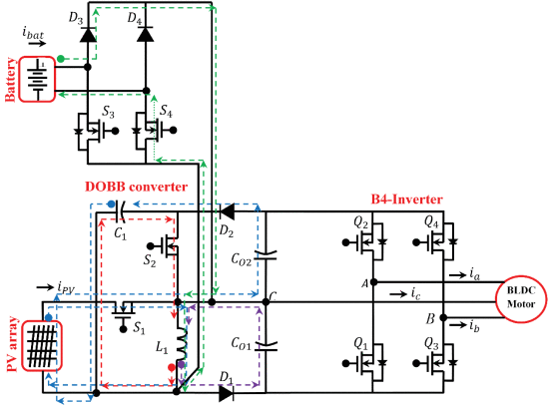
BDD Mode of operation
In mode H: The switch, S2 is turned on and switches S1, S3, S4 are turned off.
In mode I: The switch S1 is turned on and switches S2, S3, S4 are turned off.
In mode J: The switches S1 and S4 are turned on and switches S2 and S3 are turned off.
In mode K:Switch S4 is turned on and switches S1, S2 and S3 are turned off.
In mode L: Switches S1, S2, S3, and S4 are turned off.
Fig: Equivalent circuit of the proposed converter operates in BDD mode

Slide 15
Mathematical model of Proposed ITPC
During the conduction at time interval 1 , the governing equations are:
𝐿₁ (𝑑𝑖𝐿₁ /𝑑𝑡) = −𝑉_{𝐶1}
𝐶₀₁ (𝑑𝑉₀₁/d𝑡) = − 𝑉₀₁ 𝑅₁
𝐶₀₂ (𝑑𝑉₀₂i/ 𝑑𝑡) = − 𝑉₀₂ 𝑅₂
During the conduction at time interval 2:
𝐿₁ (𝑑𝑖𝐿₁/ 𝑑𝑡) = 𝑉_{𝑖𝑛}
𝐶₀₁ (𝑑𝑉₀₁/ 𝑑𝑡) = − 𝑉₀₁ /𝑅₁
𝐶₀₂ (𝑑𝑉₀₂/ 𝑑𝑡) = (𝑉_{𝐶1}+𝑉_{𝑖𝑛}−𝑉₀₂ )/𝑅₂
During the conduction at time interval 3 ,the governing equations are:
L₁ (d𝑖L₁ /dt) = −V₀₁
C₀₁ (dV₀₁ /dt )= 𝑖L₁ − V₀₁ /R₁
C₀₂ (dV₀₂ /dt) = − V₀₂ /R₂

Slide 16
MPPT With Various Controllers
In solar energy systems, photovoltaic (PV) systems are used to directly convert light into electricity. Due to its volatility, solar energy in these systems should be converted as much as possible when it is available, and this can be done by applying maximum power point tracking algorithms.
These algorithms are used to control the DC/DC converters. There are many algorithms for finding the maximum power point (MPP) of solar panels.
Some methods are simple and easy to control such as: Fractional Open-Circuit Voltage, Fractional Short-Circuit Current, Perturb-and-Observe (P&O) and the Incremental Conductance (Inc Cond).
However, there are complex methods for doing the task of tracking MPP such as Current Sweep, Fuzzy Logic Control and Artificial Neural Network. These complex methods require a lot of calculations and memory, implying the need to use more powerful microcontrollers due to heavier computational load than that of simple methods. Hence, this project proposes a simpler method of maximum power point tracking (MPPT) with high accuracy.

Slide 17
Perturb And Observe Algorithm
Perturb and observe algorithm is simple and does not require previous knowledge of the PV generator characteristics or the measurement of solar intensity and cell temperature and is easy to implement with analogue and digital circuits.
In order to increase the efficiency and to maintain the operating point at an optimum maximum power point of the PV power generation system, Maximum Power Point Tracking (MPPT) is used to track the new modified maximum power point in its corresponding curve whenever there is a variation in the temperature or irradiation and to keep maintain this point at an optimum value a power conditioner or a DC–DC converter is added as an interface between the PV generator and the load.
It extracts the maximum power from the source and transfers it to the load by stepping up (boost) or stepping down (buck) as per the requirement at the load side. The power transfer is carried out in accordance to the maximum power value by varying the on/off duty cycle of switch of the DC-DC converter.

Slide 18
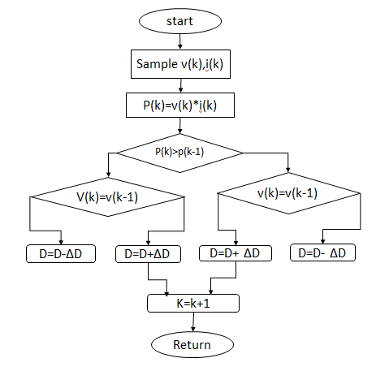
The duty cycle D of the DC/DC converter is initially set at D0. To control the panel voltage we just need to add or subtract an amount of ΔD0 to the duty cycle.
In the case that ΔD and ΔV equal to zero, the value of ΔP/ΔV is incalculable so that we have to consider the two cases of ΔP and ΔP/ΔV. The values of ΔP and ΔP/ΔV (ΔV is the voltage variation) are negative when the operating point is on the right side of MPP and vice versa.
Therefore, we can use the sign of ΔP and ΔP/ΔV to determine the required change of the panel voltage for better power extraction from the PV.
Fig: P&O Algorithm

Slide 19
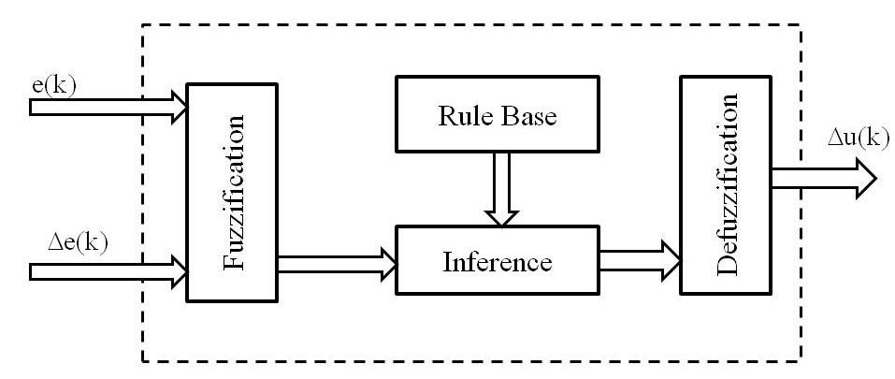
Fuzzy Logic Controller
The concept of fuzzy logic was introduced by Lotfi Zadeh (1965). A Fuzzy control system is a control system based on fuzzy logic, a mathematical system that analyses analog input values in terms of logical variables that take on continuous values between 0 and 1, which operates on discrete values of either 1 or 0 (true or false).
In general, the fuzzy logic provides an inference structure that enable appropriate human reasoning capabilities.
Fuzzy logic systems are suitable for approximate reasoning. Fuzzy logic systems have faster and smoother response than conventional systems and control complexity is less.
Fig : Fuzzy Control Internal Diagram

Slide 20
Fuzzification Module
The most important step in formulating a design for the fuzzy controller is to identify the state variables which efficiently control the plant. After figuring out the state variables, they are to be passed through the fuzzification block to fuzzify the inputs as the FLC works with only the Fuzzy inputs.
The variables generally used comprise of state error, the rate of change of state error (derivative of state error), or the area of a state error (integral of state error). The membership function is the graphical representation of the degree of belonging of an element to the fuzzy set.
For number of membership functions, the accuracy of control increases and the control works effectively. Complexity and time delay due to calculations increase with the number of membership functions taken for a linguistic variable. Hence, the number of membership functions to be used is a judgement that has to be made considering the quickness and efficiency of control to be delivered. In this model five membership functions for the Error and five membership functions for the Rate of change of error have been considered and the output has been given five membership functions.

Slide 21
Mamdani Method
Mamdani’s methods of the Fuzzy interface is the most commonly used method. It was among the first control systems built using fuzzy set theory. It was first put forward by Ebrahim Mamdani as an attempt to control a steam engine and boiler combination by synthesizing a set of linguistic control rules obtained from experienced human operators.
This inference method expects the output variable to be fuzzy sets. It is possible and also efficient to use a single spike in the output as membership function rather than a distributed fuzzy set.
This is known as singleton output membership function. It enhances the Defuzzification process because it greatly simplifies the computation required by the more general Mamdani method which finds the centroid of the two-dimensional functions.
But in the Sugeno type of inference can be used to model any inference system in which the output membership function is either linear or constant.

Slide 22
Defuzzification
A helpful Defuzzification procedure should first include the outcomes of the results together somehow. The most average fuzzy set enrolment capacity has the shape of a triangle.
Suppose, if this triangle were to be cut in a straight level line some place between the top and the base, and the top segment were to be removed, the remaining figure is in the shape of a trapezoid.
This procedure removes parts of the figures to give trapezoids if the membership function used earlier was triangular (or different shapes if the initial shapes were not triangles). Generally, these trapezoids are superimposed one upon another, giving a single shape.
Finally, the centroid of this is computed. The abscissa of the centroid gives the defuzzied output.

Slide 23
BLDC Motor
A brush less dc motor is defined as a permanent synchronous machine with rotor position feed back. The brushless motors are generally controlled using a three phase power semiconductor bridge. The motor requires a rotor position sensor for starting and for providing proper commutation sequence to turn on the power devices in the inverter bridge.
This eliminates the problems associated with the brush and the commutator arrangement, for example, sparking and wearing out of the commutator brush arrangement, thereby, making a BLDC more rugged as compared to a dc motor.
The brush less dc motor consist of four main parts power converter, permanent magnet-synchronous machine (PMSM) sensors, and control algorithm. The power converter transforms power from the source to the PMSM which in turn converts electrical energy to mechanical energy.

Slide 24
SIMULATION RESULTS
Table: Simulation Specifications of the proposed system
Sl. No | Objects | Values
1 | Maximum PV module Voltage | 51.6 V
2 | Maximum PV module Current | 9.7 A
3 | Maximum PV module Power | 500.5 W
4 | BLDC Voltage | 220 V
5 | ITPC input voltage | 51.6 V
6 | ITPC output voltage | 220 V
7 | ITPC input current | 9.7 A
8 | ITPC output current | 2.2 A
9 | Converter switching frequency | 24 KHZ
10 | Converter Duty Cycle | 81%
11 | BLDC torque | 4 N-m
12 | BLDC speed | 1250 RPM

Slide 25
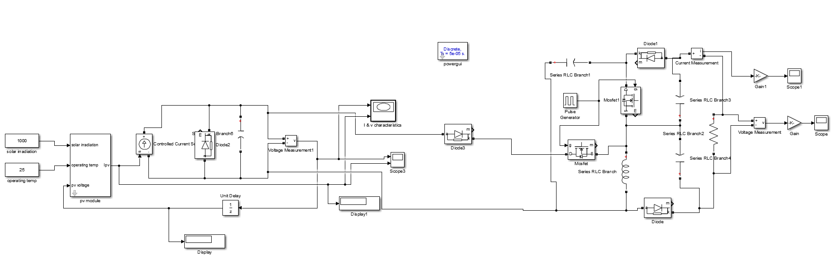
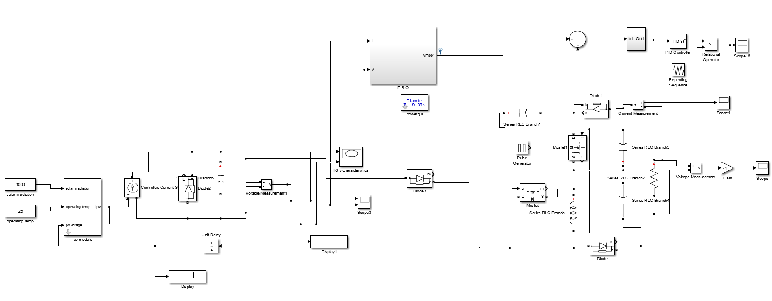
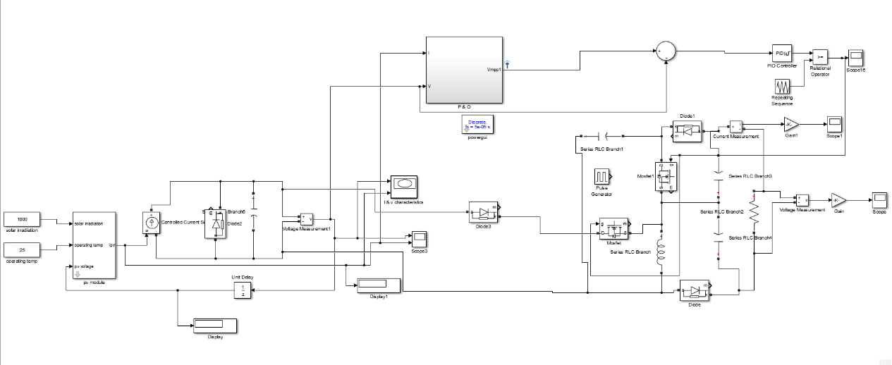
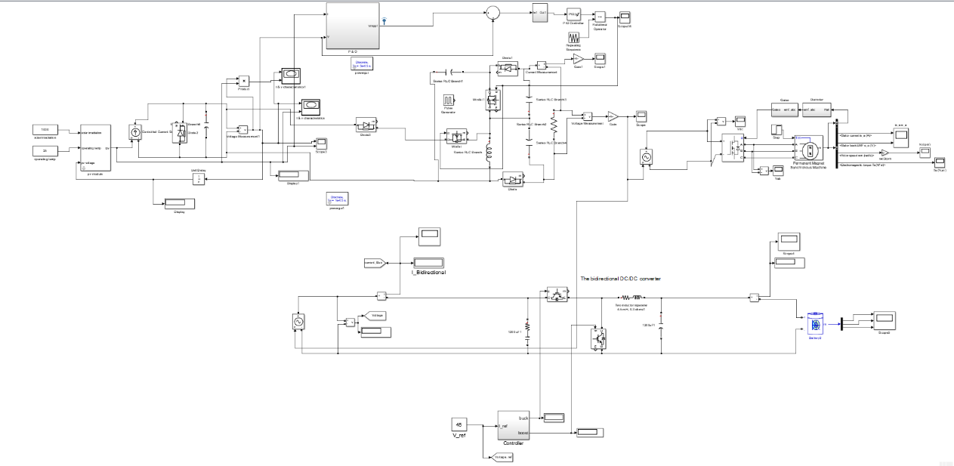
Fig 1: Simulation diagram of proposed system in PV mode
Fig2: Simulation diagram of Proposed system connected to PID with MPPT controller
Fig 3: Simulation diagram of proposed system with fuzzy controller
Fig 4: Simulation diagram of proposed system when connected to BLDC motor

Slide 26
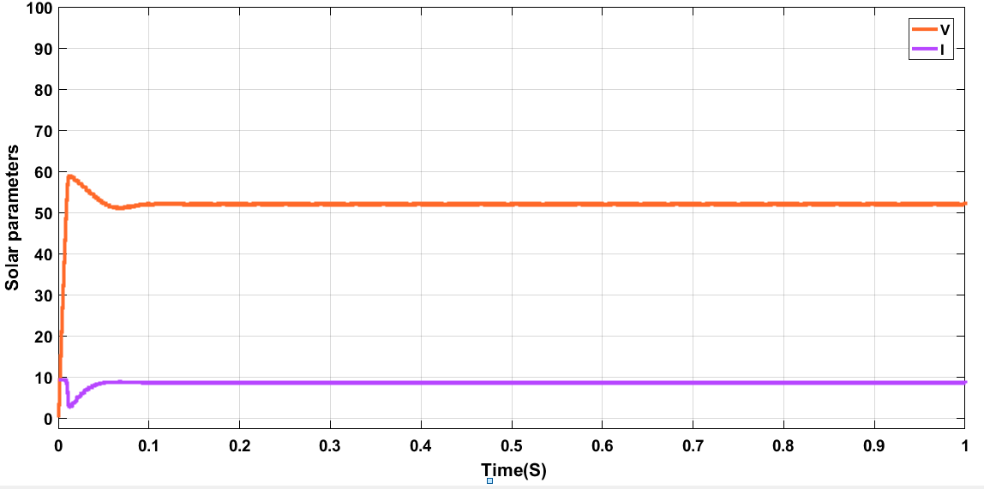
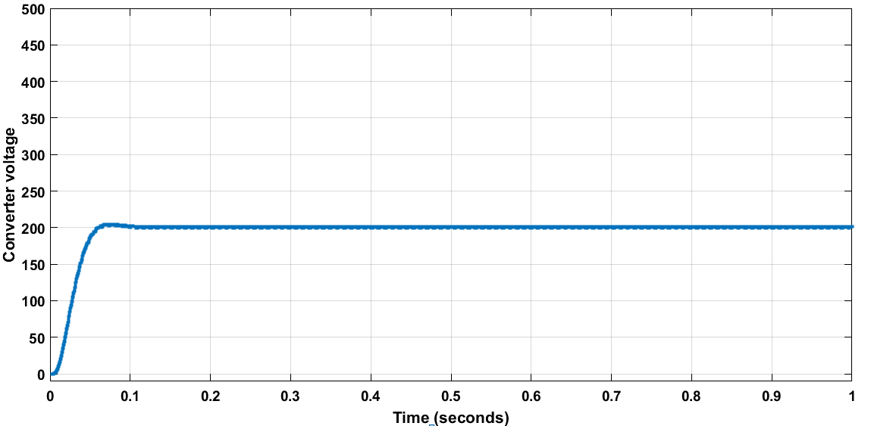
The proposed system has been simulated using MATLAB and below figure shows the output of the system with the analysis of various controllers.
Fig: Proposed system parameters with MPPT
Fig: Converter Voltage with MPPT

Slide 27
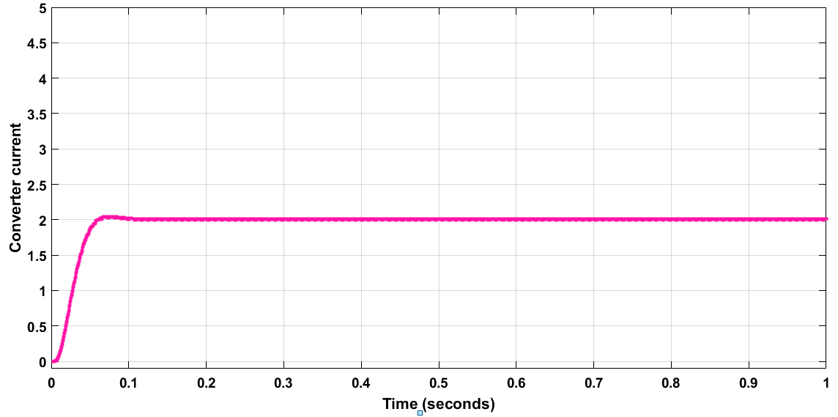
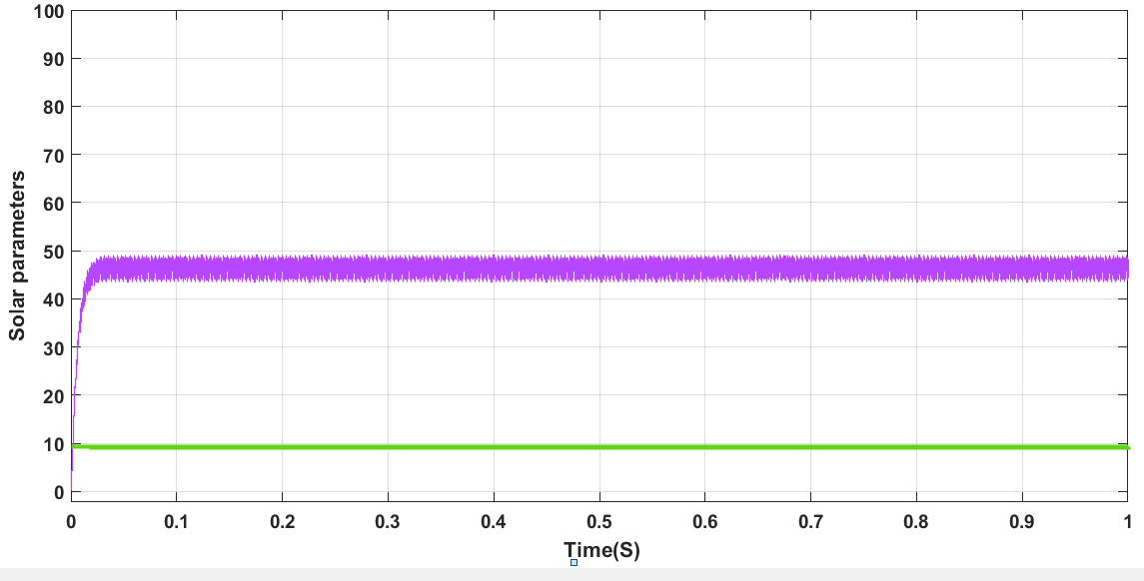
Fig: Converter Current with MPPT
Fig: Solar Parameters with PID controller with MPPT technique

Slide 28
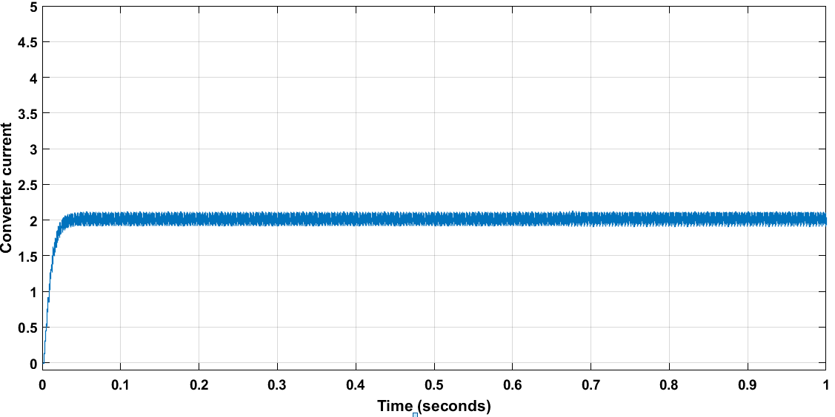
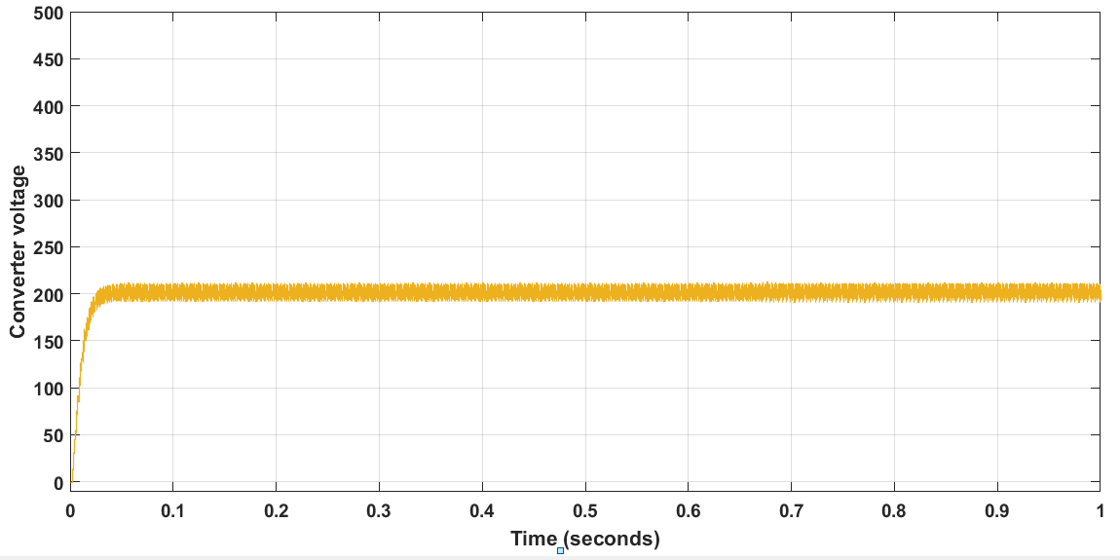
Fig: Converter Current with PID controller with MPPT technique
Fig: Converter voltage with PID controller with MPPT technique

Slide 29
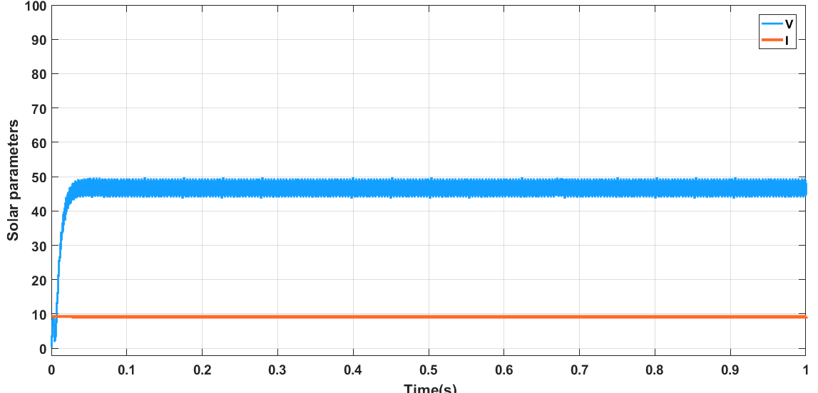
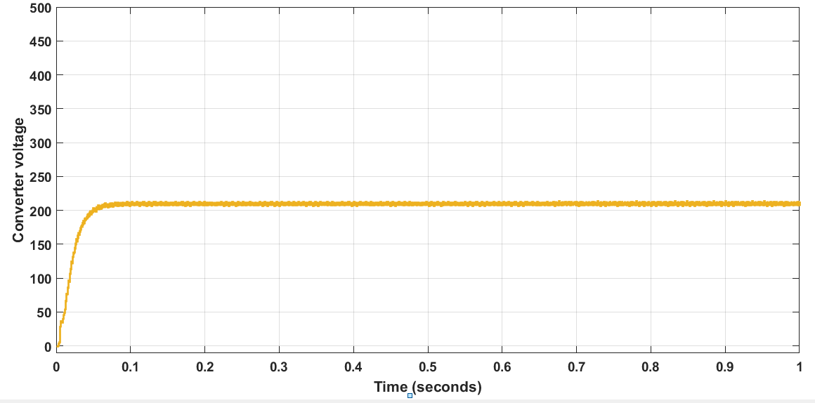
Fuzzy controller with MPPT Technique
Fig: Solar parameters of proposed system when fuzzy controller along with MPPT is used
Fig: Converter Voltage of proposed system when fuzzy controller along with MPPT is used

Slide 30
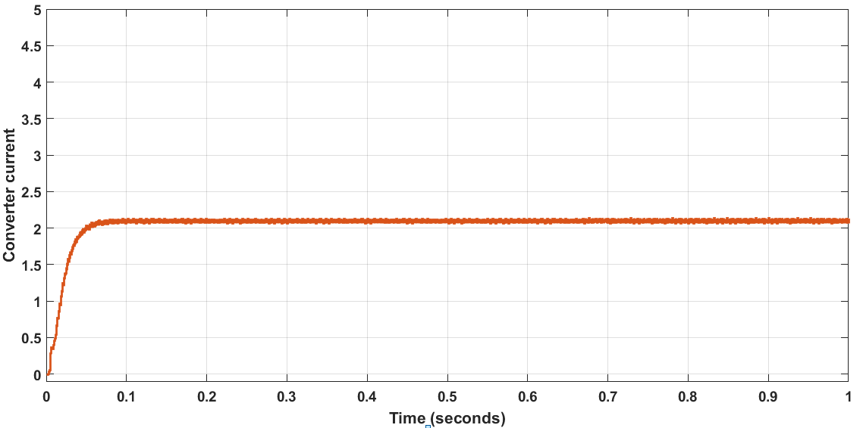
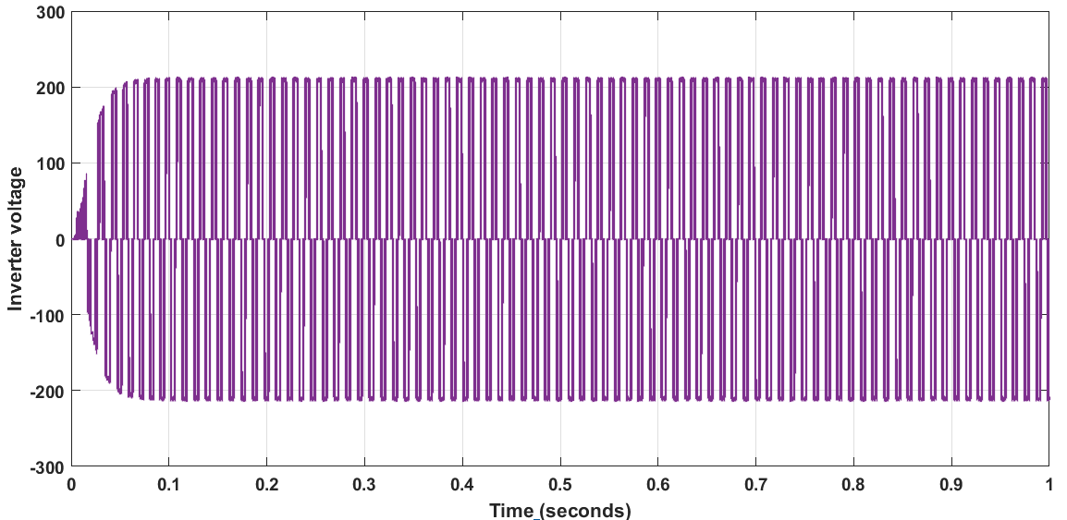
Fig: Converter current of proposed system when fuzzy controller along with MPPT is used
Fig: Inverter voltage characteristics

Slide 31
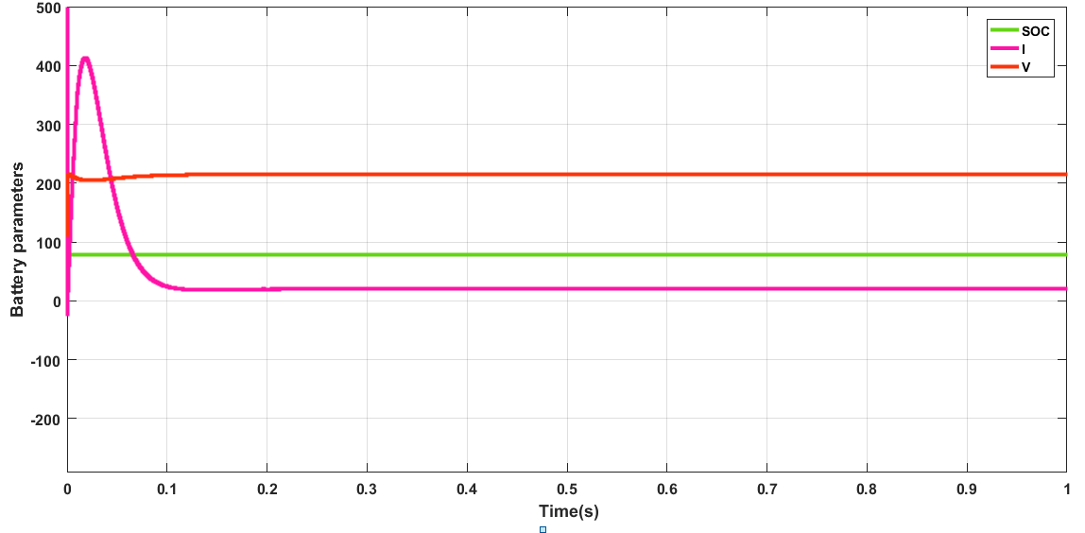
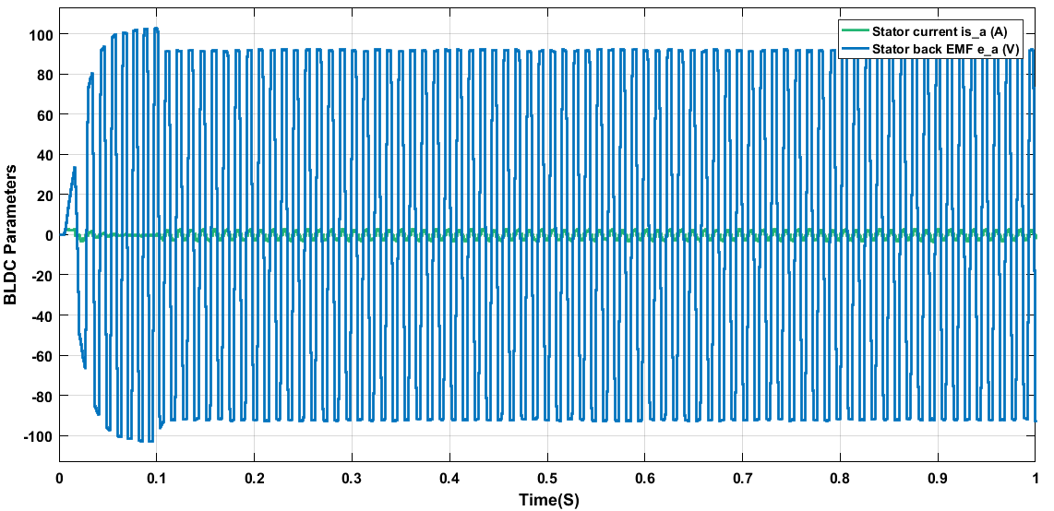
Fig: Battery Parameters
Fig: Battery parameters

Slide 32
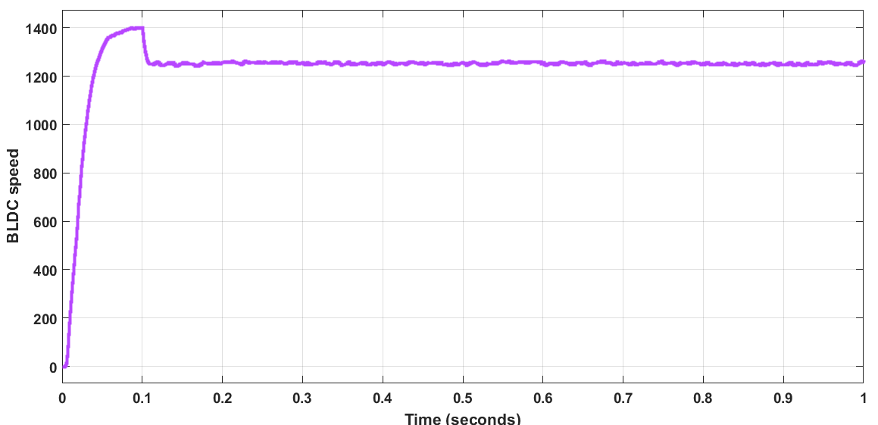
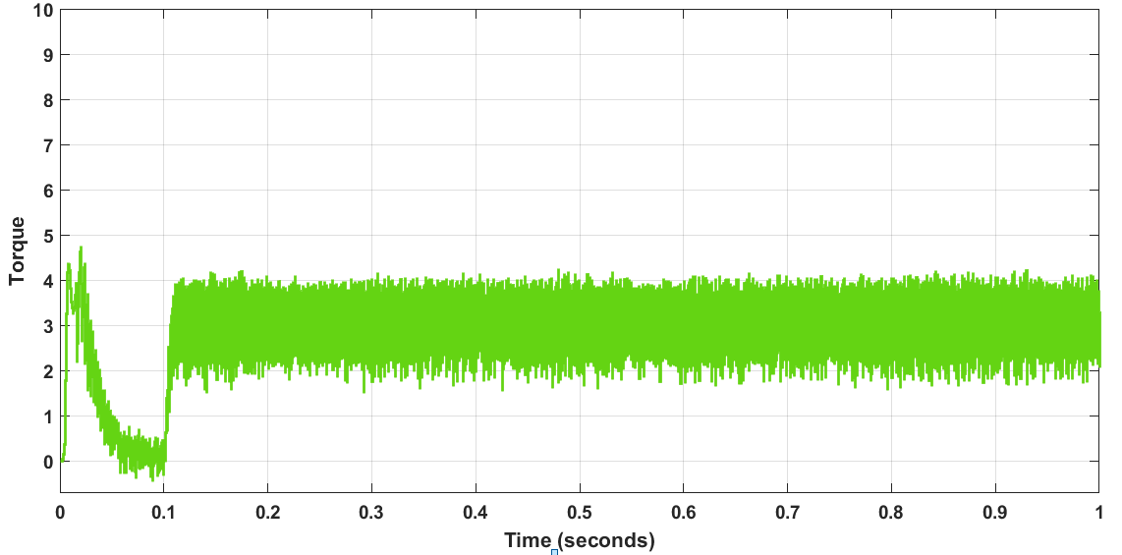
Fig: BLDC speed curve
Fig: BLDC Torque curve

Slide 33
Table : Comparison of results using various conductors
From the above table, it is clear that the ripple content is less in Fuzzy controller with MPPT technique for the proposed system. The percentage of ripple content reads around 4% only. Whereas the other techniques have more ripple contents: proposed system with PID controller has 18% and system with MPPT alone has 14% of ripple content in the output converter waveforms.
Parameter | With MPPT | With PID MPPT | With Fuzzy MPPT
Voltage | 214 | 220 | 223
Current | 1.9 | 2 | 2.1
Power | 406.6 | 440 | 468.3
Settling time | 0.1 | 0.07 | 0.05
Ripple % | 14.2% | 18.18% | 4%

Slide 34
CONCLUSION
The design of improved three interface converter, and B4-Inverter fed brushless direct electric current motor drive for industrial uses has been implemented in this project. The ITPC has been operated in unidirectional and going in both directions for accomplishing a built-in dual electric potential and power rate of flow control.
It also involves design of MPPT controller to extract maximum power from the converter under various operating conditions. The static and dynamic response of the converter has been controlled with various controllers like PID controller and fuzzy controller and the comparison has been provided among various controllers. The results are validated by performing simulations of the proposed systems in MATLAB/Simulink.

Slide 35
REFERENCES
S. K. Shanmugam, S. Ramachandran, S. Arumugam, S. Pandiyan, A. Nayyar and E. Hossain, "Design and Implementation of Improved Three Port Converter and B4-Inverter Fed Brushless Direct Current Motor Drive System for Industrial Applications," in IEEE Access, vol. 8, pp. 149093-149112, 2020, doi: 10.1109/ACCESS.2020.3016011.
Shanmugam Sathish Kumar, Arumugam Senthil kumar, Palanirajan Gowtham, Ramachandran Meena kumari, Kanagaraj Krishna Kumar Implementation of solar photovoltaic array and battery powered enhanced DC-DC converter using B4-inverter fed brushless DC motor drive system for agricultural water pumping applications. Journal of Vibro engineering, Vol. 20, Issue 2, 2018, p. 1214-1233. https://doi.org/10.21595/jve.2018.19449
Deng, Junyun et al. “An Integrated Three-Port DC/DC Converter for High-Voltage Bus Based Photovoltaic Systems.” 2018 IEEE Energy Conversion Congress and Exposition (ECCE) (2018): 5948-5953.
S. Shuvo, E. Hossain, T. Islam, A. Akib, S. Padmanaban and M. Z. R. Khan, "Design and Hardware Implementation Considerations of Modified Multilevel Cascaded H-Bridge Inverter for Photovoltaic System," in IEEE Access, vol. 7, pp. 16504-16524, 2019.
B. Singh, S. Singh, A. Chandra, and K. Al-Haddad, “Comprehensive study of single-phase ac-dc power factor corrected converters with high frequency isolation,” IEEE Trans. Ind. In format., vol. 7, no. 4, pp. 540–556, Nov. 2011.

Slide 36
THANK YOU

